Slide 1

Mary A. Marion M.Sc.(Applied Statistics) M.Sc.(Statistics) B.A.(Mathematics)
Personal Statement
Career Milestones

Slide 2
Introduction
My name is Mary A. Marion. I am an applied statistician who applies mathematical theory to my projects.
Tools
a statistics library
state-of-the-art computer setup
statistical and math packages
data prep tools (mathpix, video lan, Github).

Slide 3
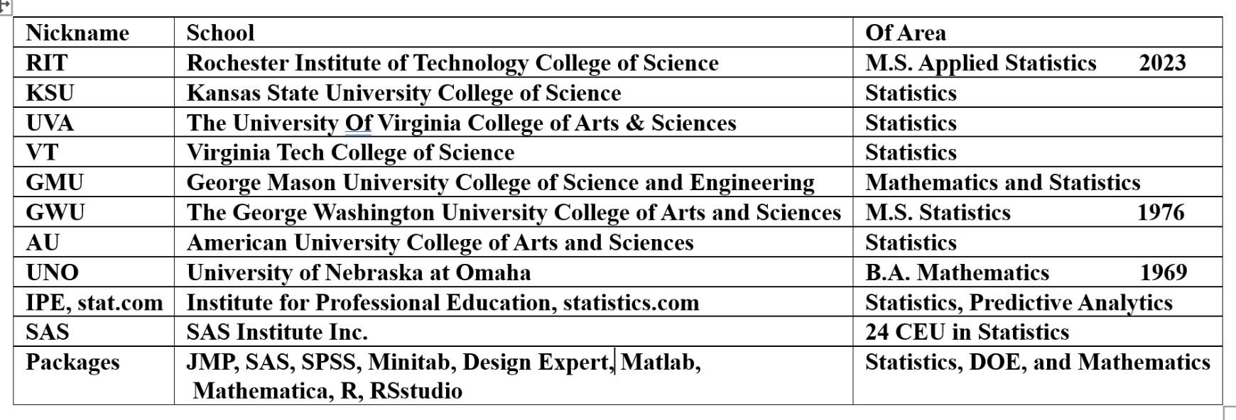
Academic Credentials

Slide 4
Work Experience
Location: private industry, federal service
I use physical science and engineering data to resolve questions of product effectiveness.
I apply mathematical statistics to quality control, hypothesis testing, DOE and statistical analyses.
I do environmental risk assessment and biostatistical analyses.

Slide 5
Work Ethic
At RIT, my most recent academic endeavor,
we blended technology, mathematics, and
statistics to inspire problem-solving through
creativity and innovation.
I believe in teamwork, cooperation, and
quality of work for your organization.

Slide 6

My Goal is Excellence in Probability and Statistics
I believe this is best achieved by constant practice and the helping of others in their analyses and educational pursuits.

Slide 7
Transition from Abstract to Work Examples
Data Science: Titanic Dataset - survivor characteristics were
examined from that fatal disaster using machine learning
Biostatistics: in Rosner’s Fundamentals of Biostatistics is a
radiology study of CT image ratings by actual disease status.
ROC curves were used to examine different cut-off
points to designate test-positive results.
For more see Mary Marion's MMSTAT WEB

Slide 8
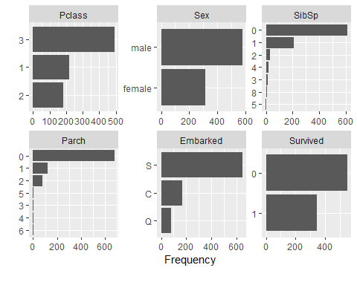
Machine Learning Statistics - Titanic Study
Outcome – survival (yes=1 or no=0,)
SibSp - number of siblings or spouse a passenger had
Parch - Number of parents/children/nanny aboard the Titanic
Embarked –Southampton, England
Cherbourg ,France
Queenstown,Ireland

Slide 9
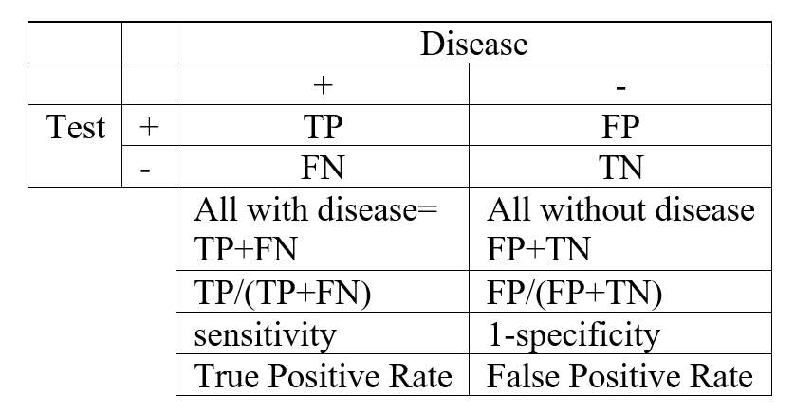
Receiver Operating Characteristic Curve (ROC)
Graphical plot illustrating the diagnostic ability of a binary classifier system (survival/no survival) as its discrimination threshold or cutoff is varied.
A ROC curve shows the clinical sensitivity and specificity relationship for every possible cut-off. Here ROC is developed from first principles
and the terms sensitivity and specificity are defined.
Table I Comparing diagnostic test with clinical truth

Slide 10
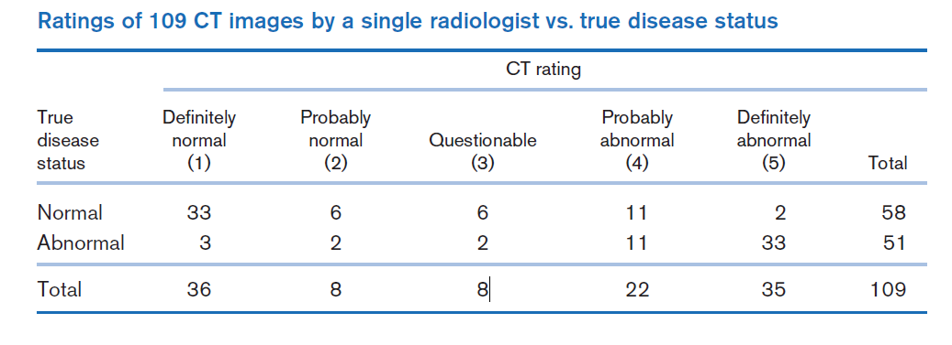
Classification Table with ROC statistics –CT Study
Table 3.3
Table 3.2 Rosner fundamentals of biostatistics, 5th ed
Sensitivity and specificity of the radiologist ratings according to different test-positive criteria based on the data in table 3.2
Test -positive criteria | Sensitivity | Specificity
1+ | 1.0 | 0
2+ | .94 | .57
3+ | .90 | .67
4+ | .86 | .78
5+ | .65 | .97
6+ | 0.0 | 1.0
Table 3.4 Practical Take Away (apply what I have learned)
Example of sensitivity and specificity use by an individual patient
Actual condition | probability [radiologist is correct] = success = S | repeat test | calculations to increase accuracy are based on probability (failure) in individual tests | after repeats accuracy increases ------------------ probability (S) increases
Normal | (33+06)/58 = 66% ~ 67% ~ 2/3 | 3 x | (1/3)³ = 4% | 96%
Abnormal | (11+33)/51 = 86% | 2 x | (.14)² = 2% | 98%

Slide 11
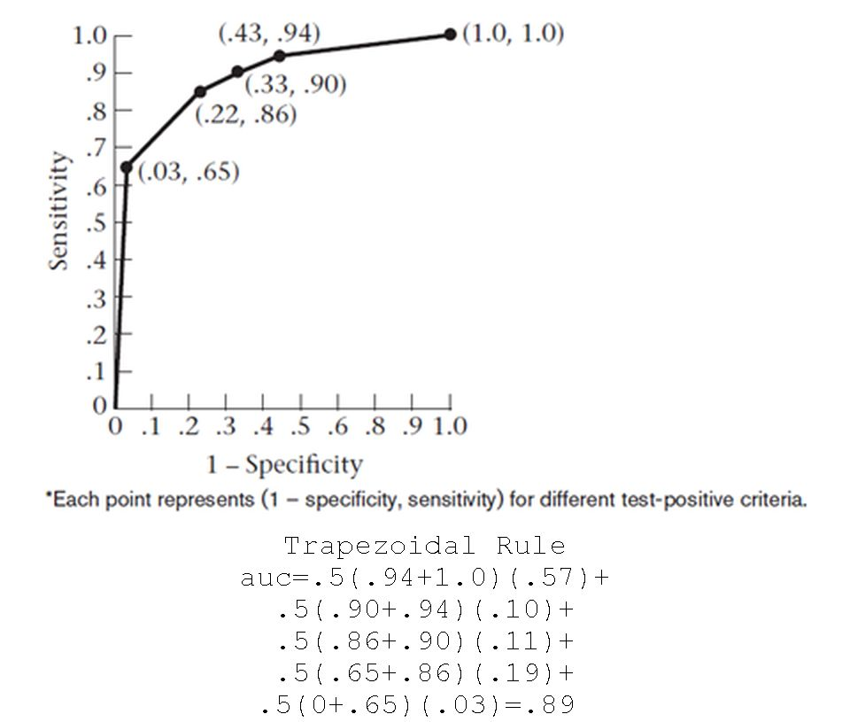
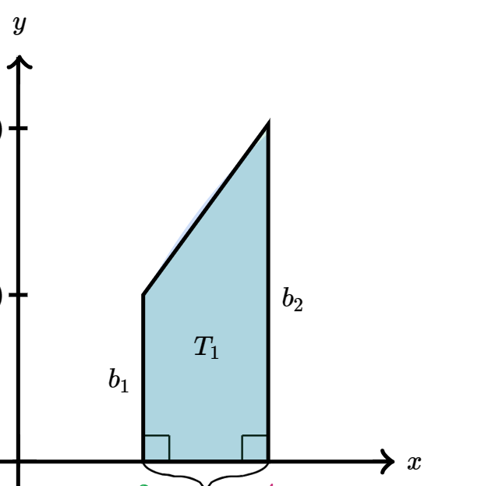
ROC Curve and the AUC
Roc curve -table 3.2
Curve points correspond to cutoff points used to designate test positive for a screening test.
AUC - the probability that the model will assign a larger probability to a random positive than a random negative observation. AUC=.89
The higher the AUC score, the more likely that correct predictions will be made by the radiologist.
think about the trapezoid as if
it's lying sideways
y-axis=Sensitivity = P[symptom| disease] = P[ +|+] = TP/(TP+FN)
x-axis=1-Specificity = P [symptom | no disease] = P[+|-] = FP/(FP+TN)
Specificity = P [no symptom |no disease] = P[ -| -] = TN/(FP+TN)

Slide 12
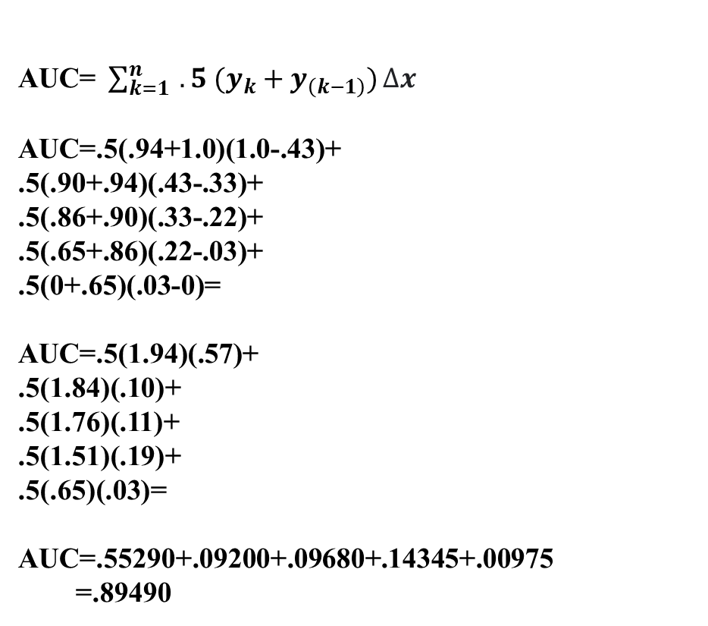
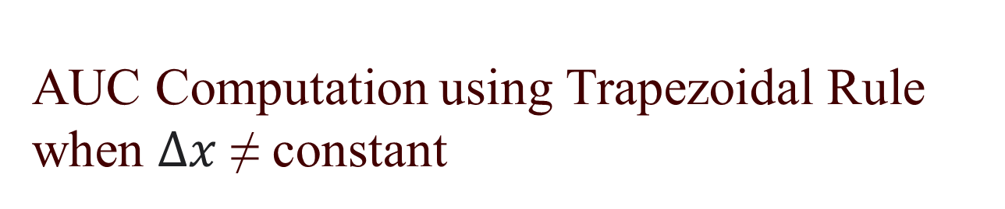
AUC Computation using Trapezoidal Rule when $∆x$ ≠ constant
AUC=$\sum_{k=1}^{n}{ .5 (y_{k}+y_{\left(k−1\right)})}∆x$
AUC=.5(.94+1.0)(1.0-.43)+
.5(.90+.94)(.43-.33)+
.5(.86+.90)(.33-.22)+
.5(.65+.86)(.22-.03)+
.5(0+.65)(.03-0)=
AUC=.5(1.94)(.57)+
.5(1.84)(.10)+
.5(1.76)(.11)+
.5(1.51)(.19)+
.5(.65)(.03)=
AUC=.55290+.09200+.09680+.14345+.00975
=.89490

Slide 13
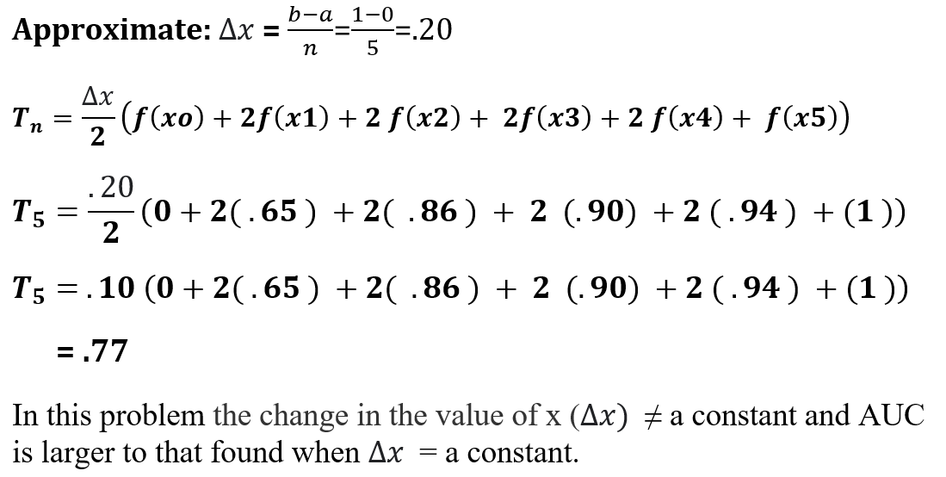

AUC Computation using Trapezoidal Rule when $∆x$ = constant

Slide 14
AUC Score Explained
>0.8 | Very good performance
0.7-0.8 | Good performance
0.5-0.7 | OK performance
0.5 | As good as random choice
AUC isn't a direct measure of model accuracy
AUC can be interpreted as a form of accuracy
the higher the score, the more likely that correct
predictions will be made.

Slide 15
Summary
I am a bit nerdy, with a never-ending interest in what makes things work.
I constantly study to develop and improve statistically based
analytical approaches for problem solving.
I balance my work with an interest in equestrian events,
swimming, and gym sports.
I enjoy family gatherings and outings.

Slide 16
THE END
This icebreaker speech is a beginning for me.
I learned new skills in its preparation.
result - better future work products.
Thank you for your attention.
I hope you learned something new as well.

